Slide 1

Spam Mail Prediction
Created By: Aman Dilip Gawade

Slide 2
Introduction:
welcome to the presentation on spam Mail Prediction. In this presentation, we will explore the problem of spam mail and how machine learning can be used to predict it.

Slide 3

What is Spam Mail?
Spam mail is known as junk mail or unsolicited bulk email, is unwanted or unsolicited electronic messages, typically send in bulk by email.
There are a number of things you can do to protect yourself from spam mail:
1.Use a spam filter.
2.Report spam mail.

Slide 4
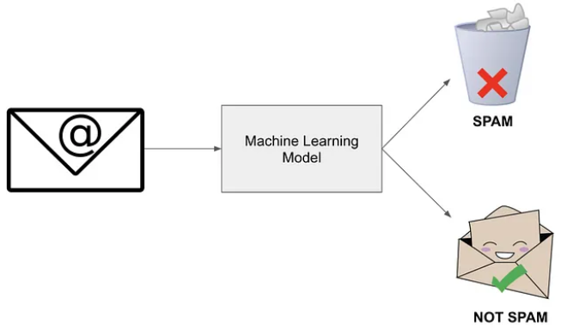
Machine Learning For Spam Mail Prediction
Machine learning algorithms can be trained on a dataset of spam and ham emails to learn the features that distinguish between the two.
There are number of diff machine learning algorithms that can be used for spam mail predictions including:
1.Logistic Regression.
2.Random Forest.
3.Naive Bayes.
4.SVM

Slide 5
The dataset
The dataset used in this project is a collection of emails labeled as spam or non-spam.
The target variable is binary classification of spam or non-spam.

Slide 6
Model Building Using PY-Spark Library
Initialize spark session
Load and prepare dataset
Feature engineering dataset
Data splitting
Model selections and training
Model evaluation
Model deployment

Slide 7
How The Algorithms Work:
Logistic Regression:
logistic regression is a machine learning algorithm that can be used to predict the probability of a binary outcome.
In this case of spam mail prediction,the binary outcome is whether an email is spam or not spam.

Slide 8
Random Forest:
To predict whether an email is spam or not spam,
The random forest algorithm first creates a numbers of decision trees. Each decision tree is trained on a random subset of the data.
The decision trees are trained to predict whether an email is spam or not spam based on a set of features such as subject line ,the body of the email, and the words that are used in the email.

Slide 9
Naïve Bayes:
Naïve Bayes is a simple but effective machine learning algorithm that can be used for spam mail prediction.
It works by assuming that the features of spam and harm emails independent of each other.
Naïve Bayes used the Bayes theorem to calculate the probability that an email is spam or harm.

Slide 10
Support Vector Machines:
SVMs works by finding a hyperplane that separates spam emails from ham emails.
The hyperplane is a line or a plane that divides the data into two regions, one from spam email and one from ham emails.
To find the hyperplane, SVMs maximize the margin between the two regions. The margin is the distance between hyperplane and the closest point of the data.
SVMs try to find a hyperplane that has the largest margin possible.

Slide 11
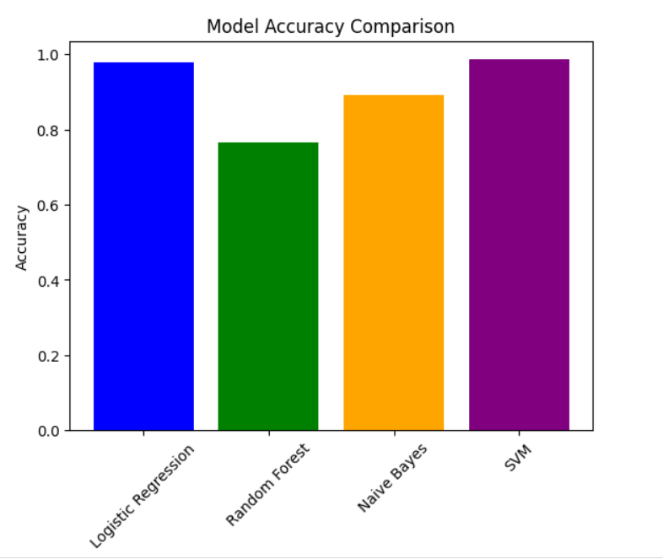
Model Accuracy Comparison
Algorithm Name
Logistic Regression.
Random Forest.
Naive Bayes.
Support Vector Machines

Slide 12
Thank
YOU

